Slide 1

Personal Finance Activity
NEEDS vs WANTS

Slide 2






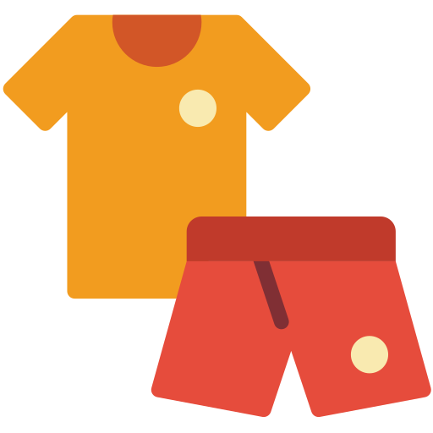





Please Do Not Edit this Slide
(For your reference)
Dessert
Books
Transportation
Water
Video Games
Fruits
Clothes
Exercise/Sports
Streaming Subscription
Bubble Tea
House
Takeout

Slide 3
Classify and place the items from the box under the appropriate sections (needs, wants, both needs and wants) in the diagram.
List of Items: drag and drop!
NEEDS
WANTS
NEEDS & WANTS

Slide 4
Think & Discuss...
1. What items did you place at the intersection of the Venn Diagram? What is the reason for this placement?
2. Discuss scenarios where the items you placed under the 'need' section can be turned into a 'want' (example: drinking water is a need but bottled water is a want).
3. As an individual, will you fulfill your needs first or your wants? Why?

